Slide 1
NCI Phase 3: The Pathways to Nature Connectedness Training Slides
Notes:
Begin with a general welcome
This presentation is split into two parts. The first will provide an overview of what Nature Connectedness is and why it is important that should take around 20 minutes to cover. The second part covers the Pathways to Nature Connectedness; the research that informed their creation, what they are and how they can be applied.
[move to slide 2]

Slide 2
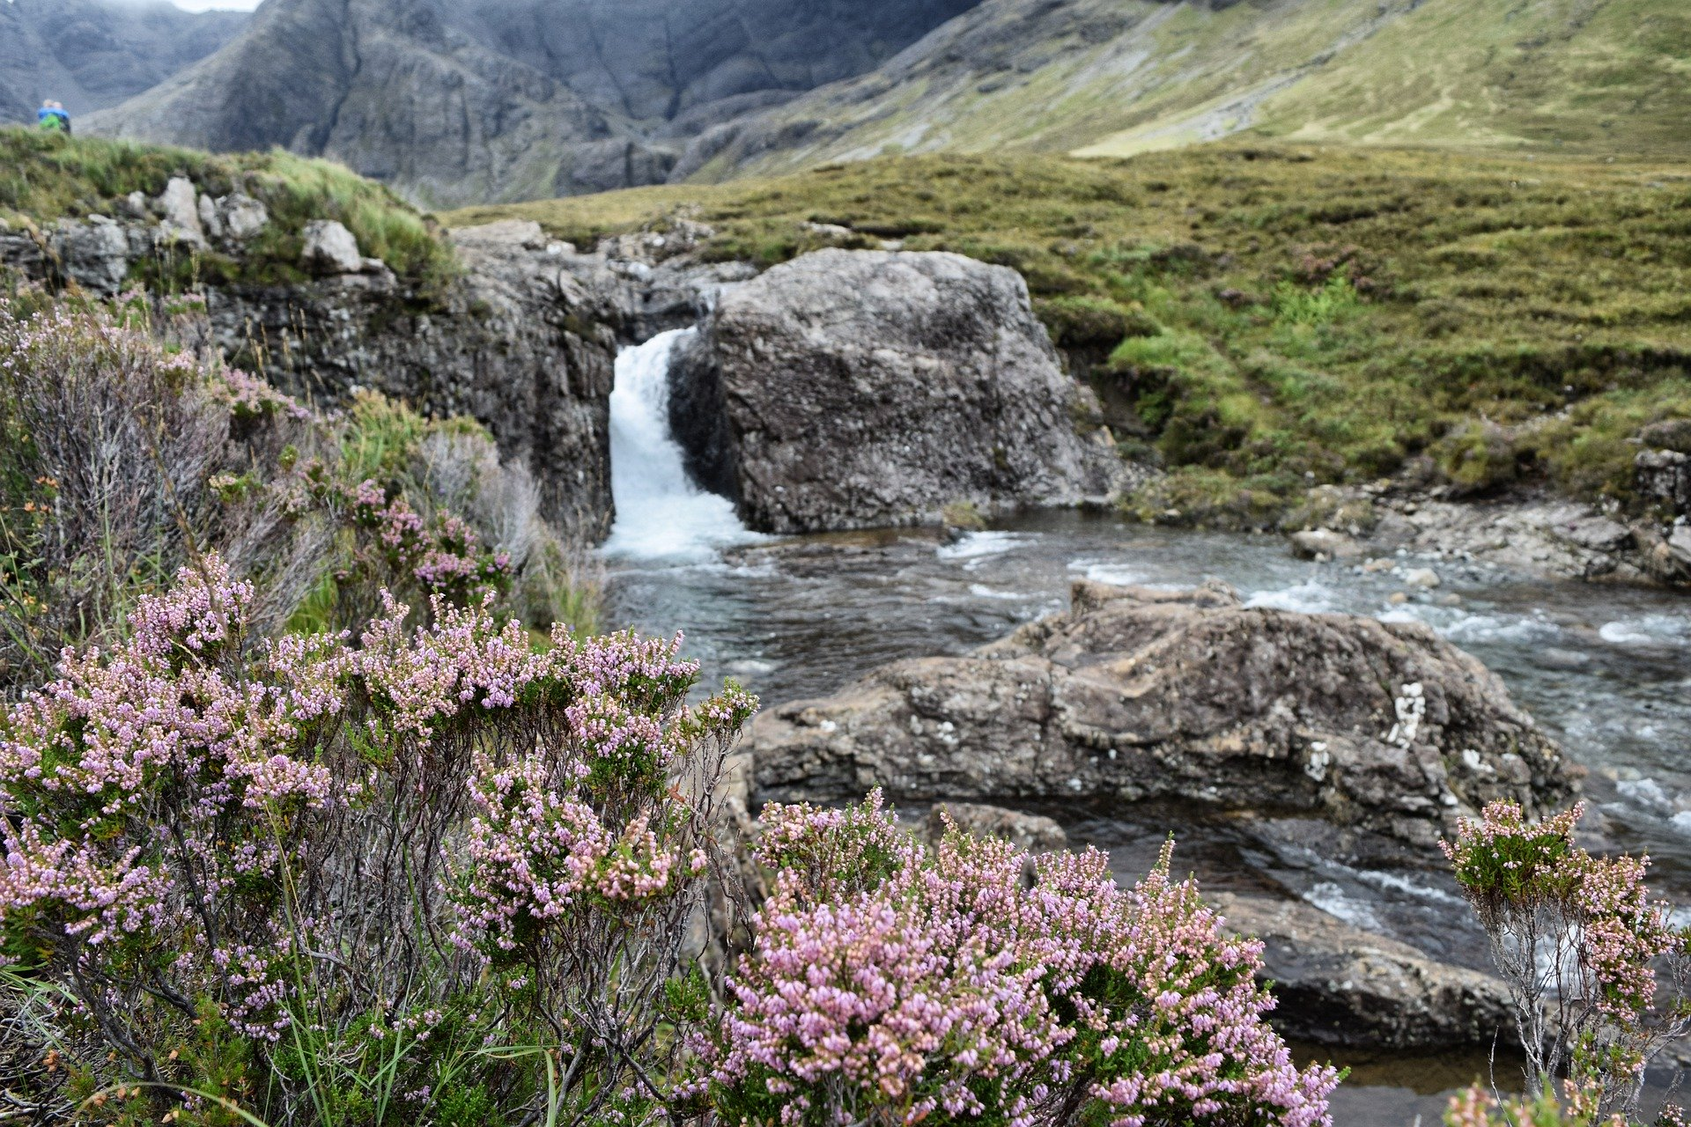
Part 1: What is Nature Connectedness and what is it good for?
Notes:
So let’s get started and look closer at what Nature Connectedness is and what it is good for…
[move to slide 3]

Slide 3
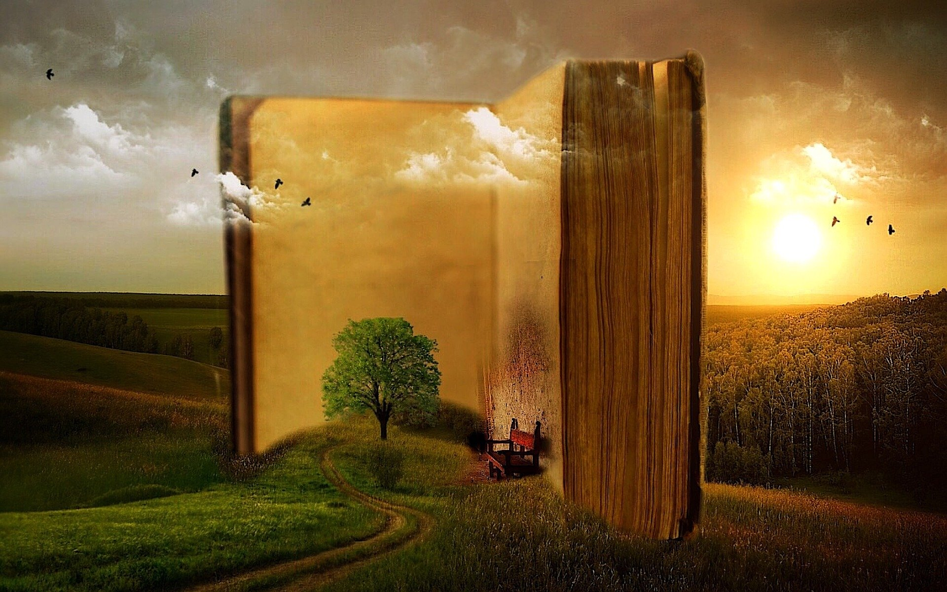
What is your Nature Story?
Recall your favourite experience with nature:
What could you see?
How did you feel?
What could you smell, touch or hear?
How important was the experience to you?
Did you feel that you and nature were similar? Did it inspire you to help it?
Notes:
What is your nature story? I suspect everyone here will have encountered something in nature that has left an impression upon you. What I’d like you to do is to take a moment to think about your most memorable positive experience in nature. But I want you to do more than simply recall it. Try to recall what you could see. Focus on how it made you feel. What could you touch, smell or hear? Consider the impact the experience had on you and its meaning in your life. Did it inspire you to help or gain a new found appreciation for nature?
Let the audience reflect on this for a minute or so before continuing
Hold onto this as we’ll revisit it later on in the session
[move onto slide 4]

Slide 4
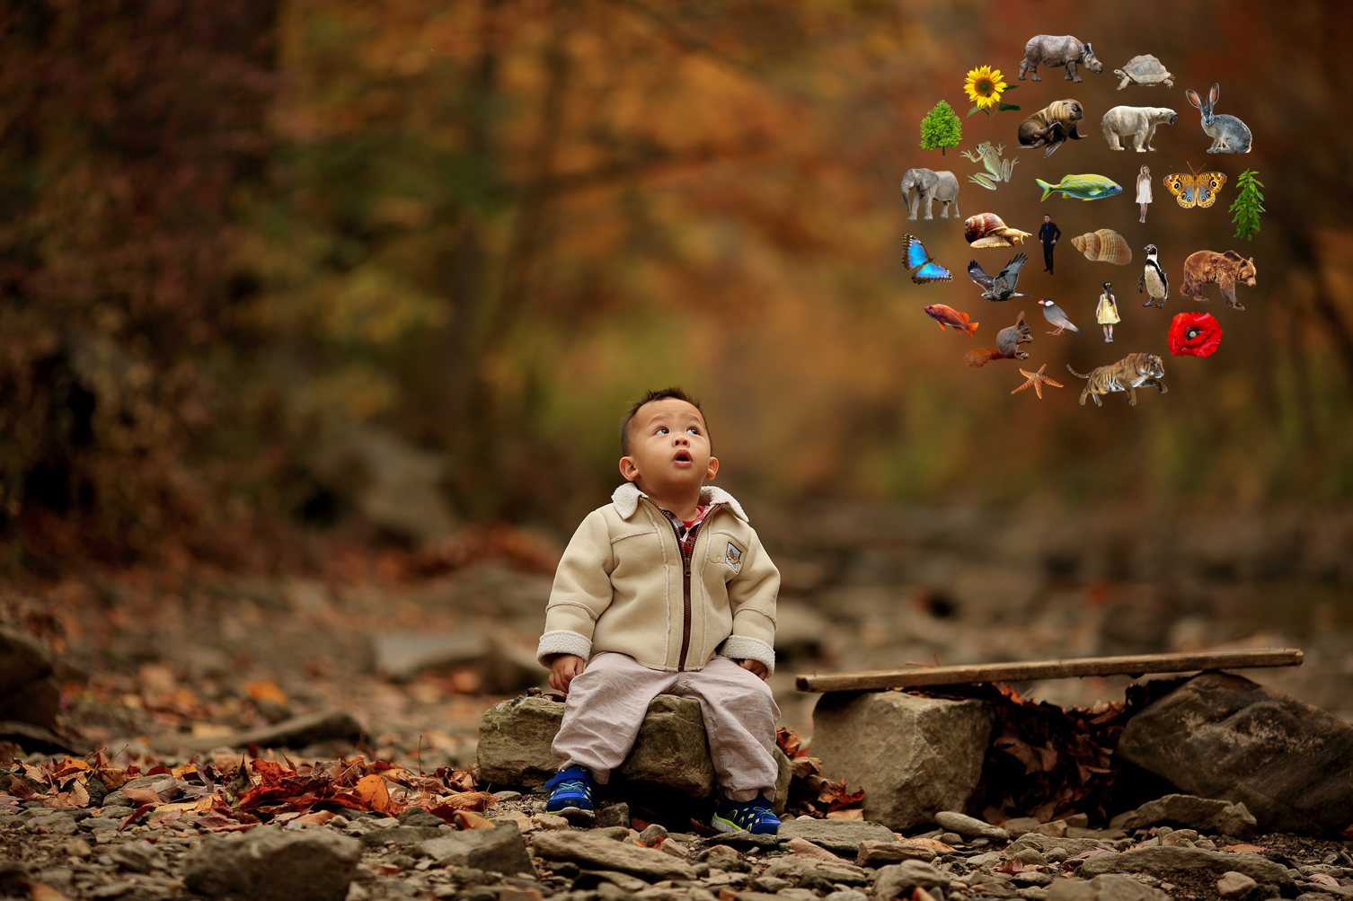
Nature Connectedness
More than simply exposure to, and contact with nature
A person’s sense of their relationship with nature
All of nature has value beyond its use by humanity with people part of a wider natural community but not superior to it
Notes:
So Nature Connectedness, what exactly is it? Some of you may be unfamiliar with the term, others more so. It is growing in relevance and popularity within organisations and the media, mentioned in the government’s 25 year plan for nature and used in programmes such as Springwatch but what is it really? It is more than simply passively engaging with nature. Just seeing, being near or within natural environments is not enough. It is more than contact. It is the feeling of belonging to a wider natural community. It is moving beyond the dominant view that humanity is somehow separate from, or even superior to nature. We are natural entities. We will always be part of nature and the things we do and what happens to the ecosystems to which we belong has an effect upon us. It is about realising and feeling this. Therefore all of nature has an important role to play in the world, a value that goes beyond how “useful” it is for humanity. Not only understanding this but feeling it is what Nature Connectedness is.
[move onto slide 5]

Slide 5
Nature Connectedness
Comprised of our thoughts, emotions, personality and experiences
An internationally recognised psychological construct
Measurable & malleable
Notes:
It is however a personal thing being subjective. If I asked each of you right now what your sense of Nature Connectedness looks like you would all likely give me different answers. This is because Nature Connectedness is made up of our thoughts, feelings, our personality as well as the experiences and learning we have had in nature. While it may be subjective, we clearly know broadly what it is as it is an internationally recognised psychological construct which means it is measurable with numerous scales designed to assess individual levels of Nature Connectedness, one of which is the Nature Connection Index which we will go over a little later on. While it is subjective and measurable, the good news is that it can be changed as it is a malleable construct especially because of the positive outcomes it has been found to produce which explains why there is growing research and applied interest in it.
[move onto slide 6]

Slide 6
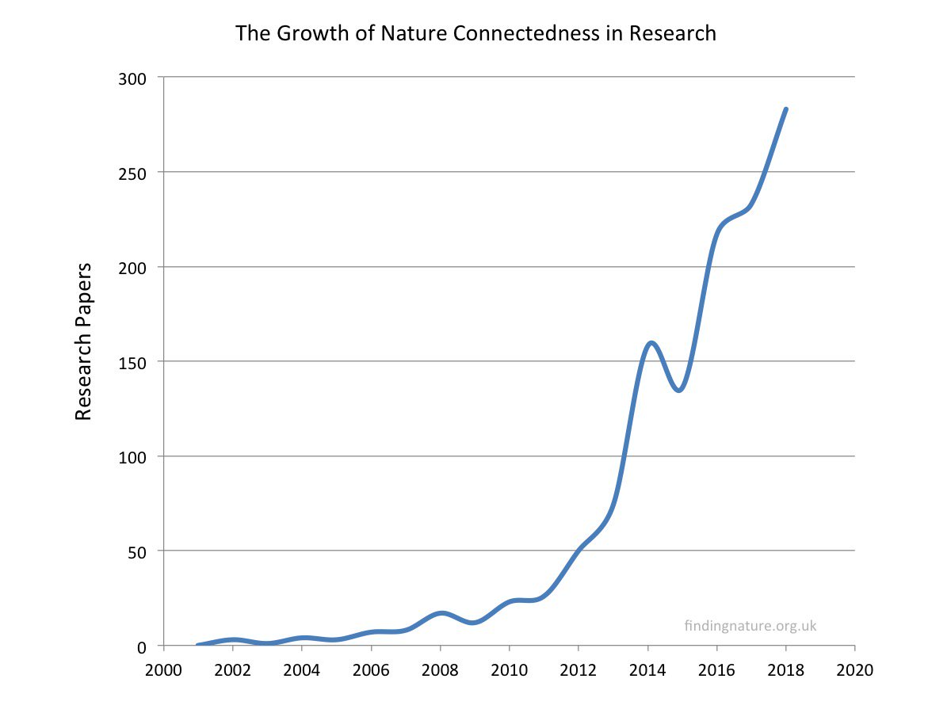
Nature Connectedness
Notes:
The graph on the screen shows the number of research papers that have investigated Nature Connectedness by year up until 2018. What is clear is that there has been a surge in interest in the topic. With this comes a wealth of research evidence on Nature Connectedness which we’ll explore further now…
[move onto slide 7]

Slide 7
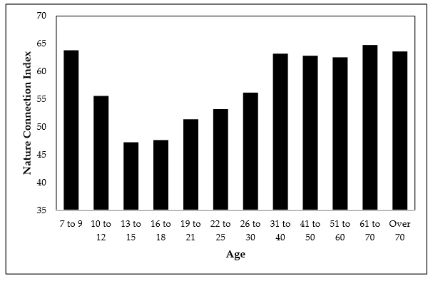
The Teenage Dip
Where Pro-Nature behaviours are more likely
Notes:
The Nature Connectedness Index or NCI was developed by a panel made up of experts from a range of organisations, headed by Natural England. The measure itself was designed to be used in small but also national surveys with a score of zero to 100 possible. The measure is simple to use with both adults and children alike. As a result, it has been utilised in the MENE surveys (Monitor of Engagement with the Natural Environment) on a national sample and has offered an interesting insight into levels of Nature Connectedness within England. You’ll see from the chart that Nature Connectedness starts high in children between the ages of 7 to 9 but begins to drop in the teenage years only to then recover to its previous level in the thirties. This teenage dip has been found not only here but in other countries including Australia, Canada and China. What exactly is behind the dip is not fully known although it does seem to be a normal part of the lifespan and is likely linked to the physiological and emotional changes experienced during puberty. What is clear is that the level of Nature Connectedness recovers broadly in line with where it begins so a higher level in childhood may be useful. What is more important however is what the survey with the NCI also showed; the level of Nature Connectedness where pro-nature outcomes are more likely to occur (press next for the animation) A score of around 71 was shown to make the majority of pro-nature behaviours more likely which is well above the average Nature Connectedness scores on the chart by age and the national average of 61. This is particularly concerning given the outcomes that Nature Connectedness has been linked to…
[move onto slide 8]

Slide 8
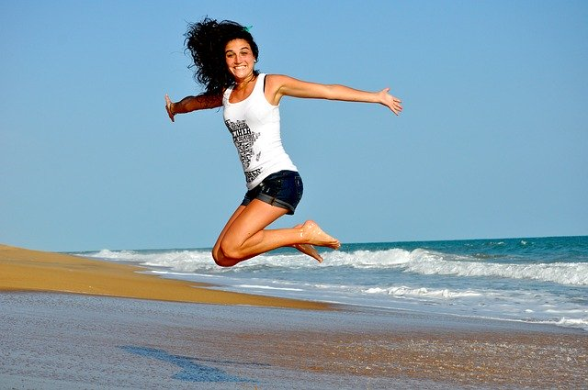
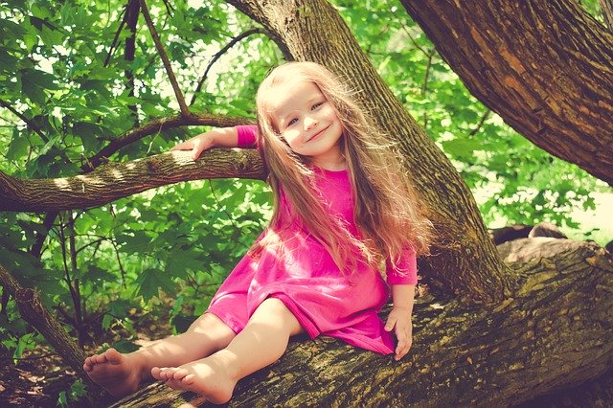
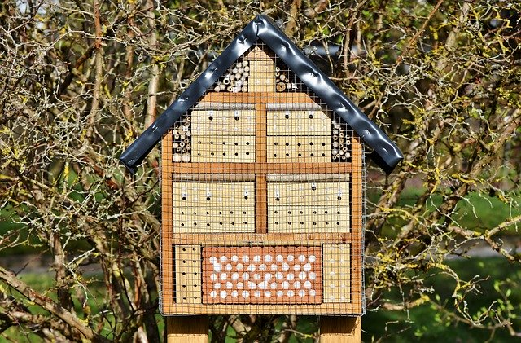
Why does this matter?
Health Wellbeing Pro-nature outcomes
Nature Connectedness is good for the wellbeing of all of nature (humanity included!)
Notes:
Nature Connectedness matters because research has shown it to be linked with better health and wellbeing as well as the performance of pro-nature behaviours; all of which are growing issues within society that we need to address. Put simply, Nature Connectedness is good for the wellbeing of all of nature (humanity included!) let’s take a look at these outcomes in a little more detail.
[move onto slide 9]

Slide 9
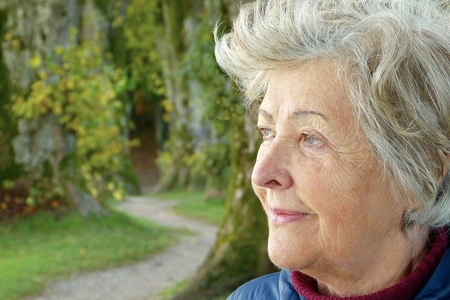
Health
If you are connected, you are more likely to spend time in nature so you can gain direct benefits to your health
Nature Connection has been linked with the ability to cope leading to better immune system functioning that is suggested to account for many health-related benefits from nature
Notes:
Nature Connectedness is linked to health benefits in two main ways. Firstly, because it is a relationship, just like with other people, if we are in any kind of positive relationship with others we want to spend time with them and Nature Connectedness is no different; the more Nature Connected you are, the more likely you are to spend time in nature. With this comes the health benefits from exercise, cleaner air etc. that comes from spending time in natural spaces. Secondly, Nature Connectedness has been linked with the ability to cope in times of stress. Being able to cope with stressors leads to improved immune functioning and resilience to disease with an improved immune system suggested to be the central pathway through which we experience health benefits from Nature Connectedness.
[move onto slide 10]

Slide 10
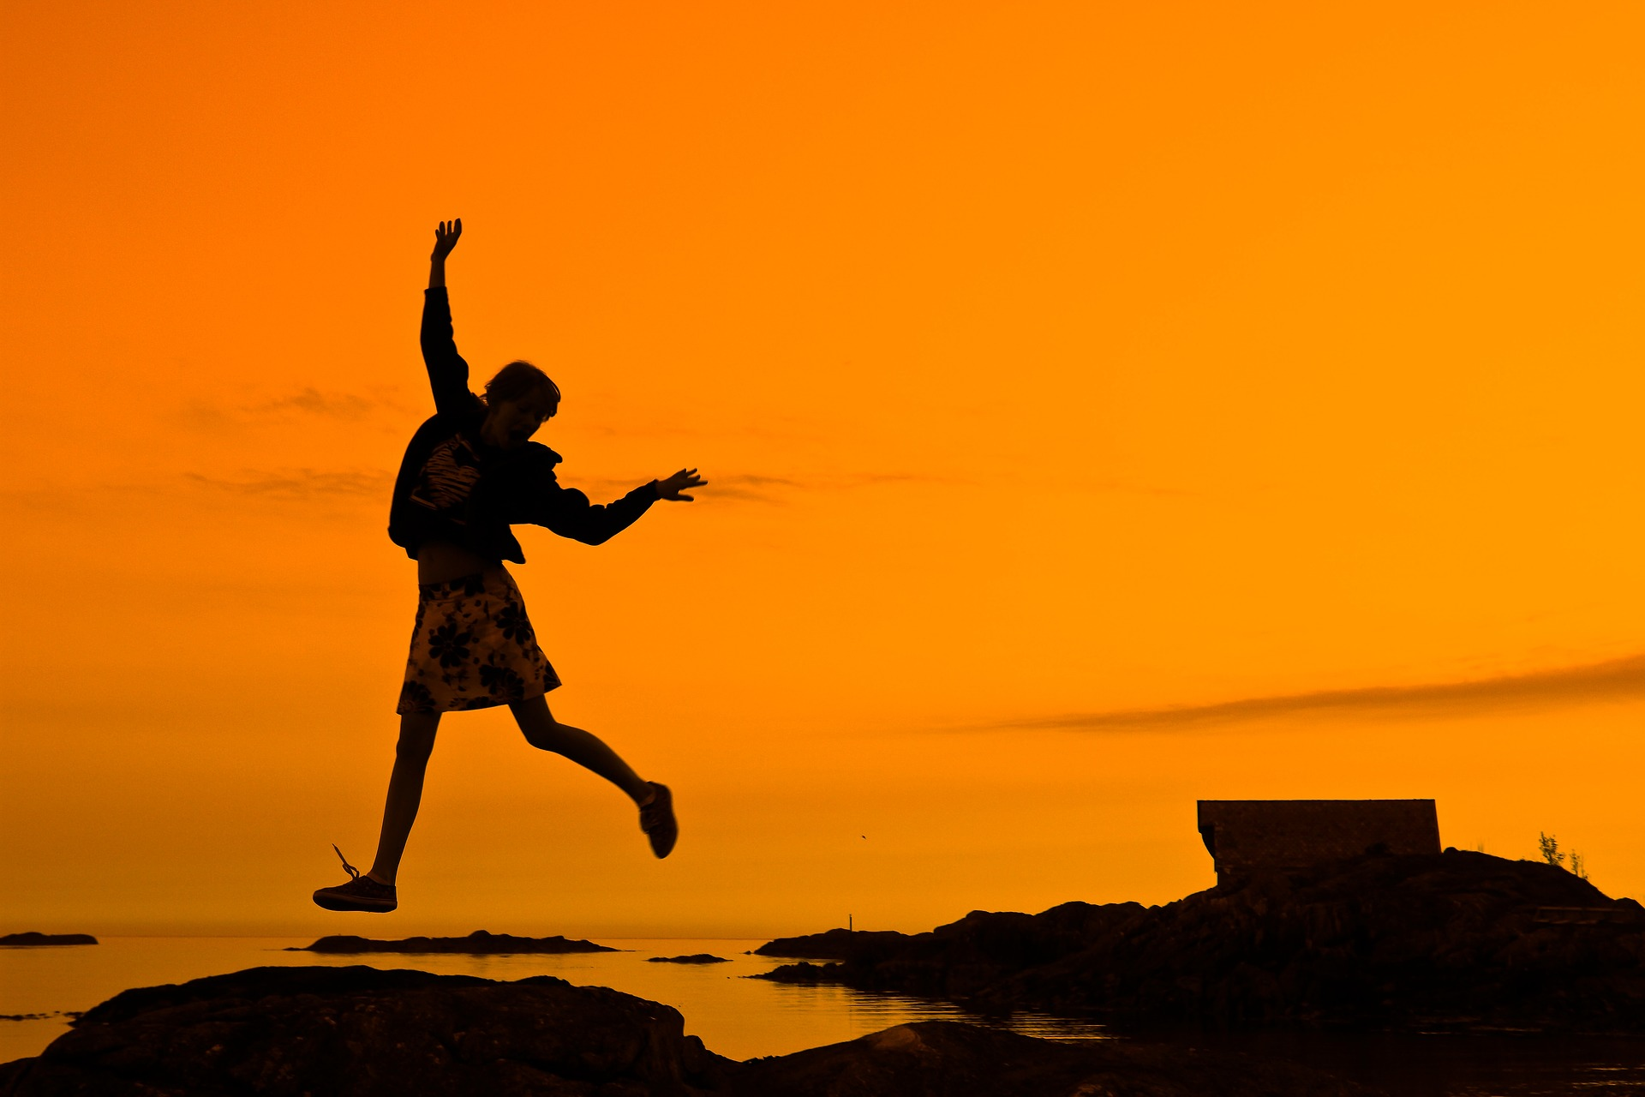
Wellbeing
Vitality
Independent (and better) predictor of well-being than exposure – NCI Project
Systematic review of 32 studies shows nature connection related to feeling good & functioning well.
Meaning & Purpose
Life Satisfaction
Happiness
Personal Growth
Pro-social Behaviour
Body Image
Lower Anxiety
Notes:
Research has shown that not only does Nature Connectedness predict a large range of wellbeing outcomes, but that it does this independently of, and better than exposure to natural environments. Several reviews have looked into the wellbeing benefits of Nature Connectedness one of which, a Systematic Review of 32 papers showed Nature Connectedness relates to feeling good and functioning well with some indicators of this including vitality, meaning and purpose, life satisfaction, happiness, personal growth, improved body image, lower anxiety and increased pro-social behaviours.
[move onto slide 11]

Slide 11
Pro-Nature Behaviours
Study of children’s environmental education found that environmental knowledge explained 2% of ecological behaviour.
Nature connectedness explained 69%
Otto & Picini, 2017
Notes:
While the personal health and wellbeing of people is important, the health of the ecosystems and the species they contain is also of concern. Enacting pro-nature behaviours is one way in which the health of our ecosystems can be maintained, with knowledge an oft used way to encourage such behaviours. While knowledge plays a role, it only accounted for 2% of self-reported pro-nature behaviours with Nature Connectedness explaining 69%. As with other relationships, our actions are influenced more by how we feel than what we think; our actions towards nature are no different.
[move onto slide 12]

Slide 12
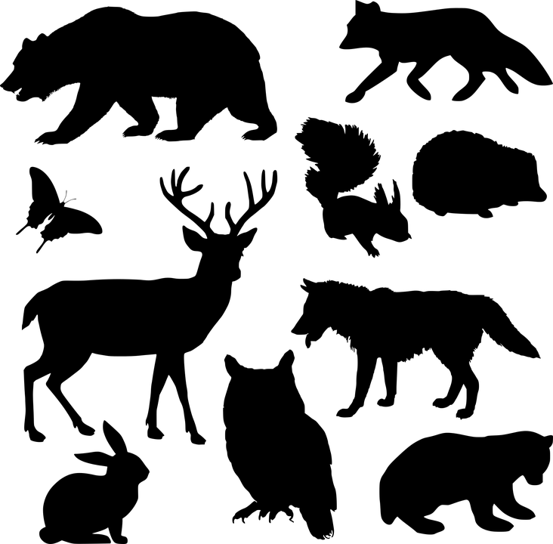
80% Mammals Lost – 60% of Wildlife Since 1970!
36%
60%
4%
Bar-On et al. 2018
Notes:
We know that our environment and the species it contains is in crisis. The slide here summarises the current make up of mammalian life on Earth with 60% made up of livestock, 36% humans and the remaining 4% everything else. It is clearly a human-made issue that requires a human solution. From the levels of Nature Connectedness we have seen outlined today, it is clear there is room for improvement as our relationship with nature is broken. But there is hope as this relationship can be improved with the health and wellbeing of all of nature, including humanity, standing to benefit through Nature Connectedness.
[move onto slide 13]

Slide 13
So how do we get there?
Notes:
Nature Connectedness is clearly important for the health and wellbeing of all of nature. It has a role to play in addressing some of the challenges we currently face to our own health and wellbeing as well as that of wider nature. But if the current levels of Nature Connectedness are insufficient to achieve this, how do we improve them? The Pathways to Nature Connectedness framework offers a possible solution…
[Move onto slide 14]

Slide 14
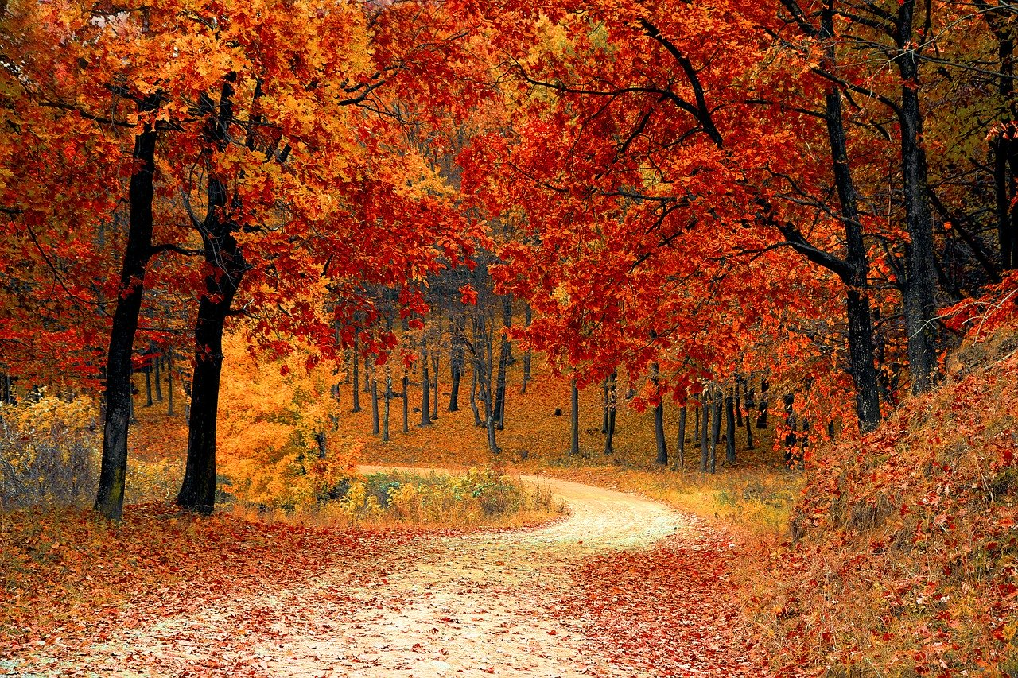
Part 2: Pathways to Nature Connectedness
Notes:
This may be a good opportunity for a short break depending on the audience and time available.
In this part we’ll look at the Pathways to Nature Connectedness Framework to give you an idea of how to reconnect people with nature using an evidence-based approach.
[move onto slide 15]

Slide 15
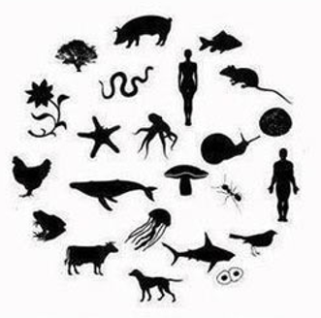
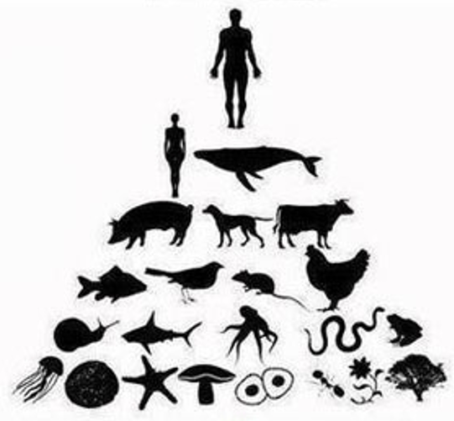
Pathways to Nature Connectedness
Based on Kellert’s values of Biophilia
3 year programme of research (PhD)
Five studies in total (Quantitative & Qualitative)
?
Notes:
The Pathways framework was developed at the University of Derby by Dr Ryan Lumber during a 3-year PhD. Drawing upon the nine values of the Biophilia Hypothesis that describe nine board ways in which humanity affiliates with nature, five research studies using both qualitative and quantitative methods were conducted to ascertain the important routes or frames that lead to Nature Connectedness.
[move onto slide 16]

Slide 16
Pathways Research
Two questionnaire surveys
Investigating what people said they did in nature and related this to nature connectedness Identified five pathways that explained up to 64% of why people are nature connected
An experiment
Three groups of people:
Those walking in nature,
Those walking in nature and engaging with pathways
Those walking in an urban setting (indoors) and engaging with pathways
Only walking in nature while engaging with the pathways led to significant increases in nature connectedness from before to after
Notes:
The three quantitative studies are of particular interest and are covered here. In order to first ascertain what potential pathways existed that lead to Nature Connectedness, two surveys were conducted that asked peoples frequency of engagement with a range of activities (structured around the nine values of Biophilia) while also looking at their levels of Nature Connectedness. The survey was run and then repeated with the Pathways identified consistently demonstrated. In total, the identified Pathways accounted for between 57-64% of why people are Nature Connected. As the two studies looked at a set point in time (cross-sectional) an experimental study was performed to test the identified Pathways and their ability to increase Nature Connectedness. 72 people took part in a walking study with all walks of an equal length. 24 people simply walked in an urban nature setting. 24 people did the same walk but engaged with Pathway-based activities. A further 24 walked indoors while also engaging with Pathway-based activities. Of the three groups only the nature walk with Pathway activities led to a significant increase in Nature Connectedness.
So the Pathways have been shown to increase Nature Connectedness in a meaningful way but what are they exactly? The next five slides discuss each one in more detail with suggested activities to utilise them. Do note however, that it is a Pathways framework rather than a prescriptive account of what should be done as many activities can be framed through the Pathways to help facilitate a reconnection with nature.
[move onto slide 17]

Slide 17
The Five Pathways
Notes:
Press play to watch a video describing the five Pathways
[move onto slide 18 when finished]

Slide 18
Contact (Senses)
What is it?
Going beyond passive interactions with nature
Tuning in to nature through the senses by noticing and fully engaging it
Things you can try:
Listening to birdsong
Smelling wild flowers
Watching the breeze in the trees
Going barefoot
Tasting the fruits of nature
Notes:
Contact through the senses is the first pathway that emphasises moving beyond simple exposure with nature to something that actively engages our senses to tune in and engage with nature in a fuller way. It is about taking the time to notice nature and experience it with any of the senses that you can whether that is through sight, sound, touch, smell or taste. Some potential ways to do this include:
Listening to birdsong
Smelling wild flowers
Watching the breeze in the trees
Going barefoot
Tasting the fruits of nature
[move onto slide 19]

Slide 19
Emotion
What is it?
Not just thinking in nature but feeling
Feeling alive through the emotions nature brings by engaging emotionally with it.
Things you can try:
Finding joy in wildlife at play
Taking a moment to feel calm in nature
Finding wonder in a spiders’ web
Reflect and share your feelings about nature with others
Notes:
Emotion is the second Pathway that is focused on not just thinking when in nature but engaging emotionally to it; feeling alive through the emotions nature brings. It is about the whole range of emotions and while finding happiness and wonder, and joy and calm in nature are great ways to help foster Nature Connectedness, nature can also be embraced during times of sorrow too. Some potential ways to help reconnect with nature through emotion include:
Finding joy in wildlife at play
Taking a moment to feel calm in nature
Finding wonder in a spiders’ web
Reflect and share your feelings about nature with others
[move onto slide 20]

Slide 20
Beauty
What is it?
Going beyond passive viewing of nature
Noticing the beauty in nature and appreciating it every day
Things you can try:
Create some wild art
Paint the amazing colours of insects
Take a photo of a flower
Visit a place with a wonderful view
Notes:
The third Pathway is Beauty where moving beyond a passive viewing of nature to notice the beauty it contains is important for Nature Connectedness. It is about finding and appreciating the beauty in all of nature, whether spectacular or mundane and to do this every day and to express this in some way, through art or words. Some ways that beauty can be used to reconnect with nature include:
Create some wild art
Paint the amazing colours of insects
Take a photo of a flower
Visit a place with a wonderful view
[move onto slide 21]

Slide 21
Meaning
What is it?
Moving away from isolating nature as something we are in
Nature bringing meaning to our lives; celebrating the mystery, signs and cycles of nature
Things you can try:
Create a story about a tree
Map the journey of a bee
Celebrate the longest day, the first swallow of summer or the first fall of leaves
Letting nature be your story
Notes:
Meaning is the fourth Pathway and is focused on bringing meaning to our lives through the celebration of the mystery, signs and cycles of nature rather than isolating it as something we meet; making it a part of our identity and our lives. By exploring and expressing the meaning nature has to and for us, a sense of belonging, purpose and fulfilment can be created to the wider ecosystems to which we belong. Some ways in which meaning can be used to reconnect with nature include:
Create a story about a tree
Map the journey of a bee
Celebrate the longest day, the first swallow of summer or the first fall of leaves
Letting nature be your story
[move onto slide 22]

Slide 22
Compassion
What is it?
Moving beyond a purely anthropocentric focus
Caring and taking action for nature by embracing our similarity with our natural family
Things you can try:
Feed the birds
Plant some wildflowers
Take part in a beach clean
Put up a nest box
Watch a wild family grow
Support conservation charities or buy eco-friendly products
Notes:
Compassion is the fifth Pathway that moves us away from a focus on our own species to notice the similarity we have with the rest of nature by recognising the shared life stories we have and the community we coexist within. This inspires us to care and take action for nature to protect it so that all of our natural family can thrive. Compassion can be help reconnect people with nature through:
Feeding the birds
Planting some wildflowers
Taking part in a beach clean
Putting up a nest box
Watching a wild family grow
Supporting conservation charities or buy eco-friendly products
[move onto slide 23]

Slide 23
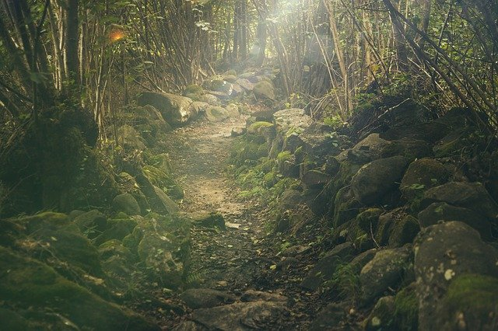
What are not Pathways
Using nature purely for survival needs
Controlling or dominating nature
Studying nature for facts and figures
Avoiding nature or being fearful of it
Notes:
While we know what act as Pathways to Nature Connectedness, we also know what are not helpful in promoting it:
Using nature purely for survival needs
Controlling or dominating nature
Studying nature for facts and figures
Avoiding nature or being fearful of it
As the Pathways are a framework, it is important to remember that some of these aspects can be re-framed to help reconnect people. Finding the joy in understanding more about nature or the meaning in the sustenance nature provides are just two examples where Nature Connectedness can occur through simple act of reframing
[move onto slide 24]

Slide 24
What is your Nature Story?
Recall your favourite experience with nature:
What could you see? (Beauty)
How did you feel? (Emotion)
What could you smell, touch or hear? (Contact)
How important was the experience to you? (Meaning)
Did you feel that you and nature were similar? Did it inspire you to help it? (Compassion)
Notes:
Earlier I asked you what your nature story was. Hopefully as we’ve gone through the Pathways you will have recalled your own favourite experience and have begun to see how the Pathways may have been present within it. Now they might not all have been there but some will have been at least. The Pathways of Contact, Emotion, Beauty, Meaning, and Compassion are accessible and can be found in all nature encounters whether great or small, wherever they take place. This is why they work as a practical and accessible framework when engaging people with nature to help facilitate Nature Connectedness.
[move onto slide 25]

Slide 25
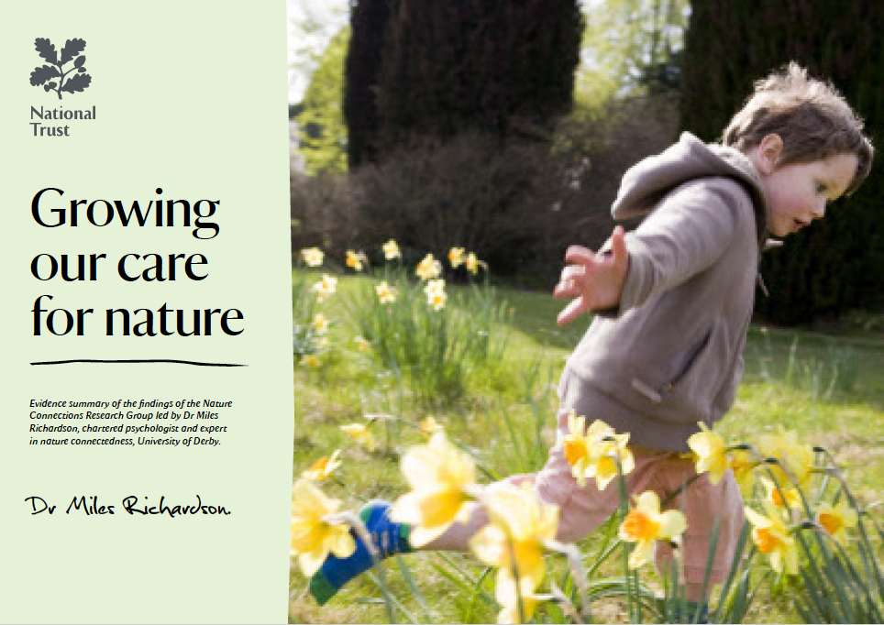
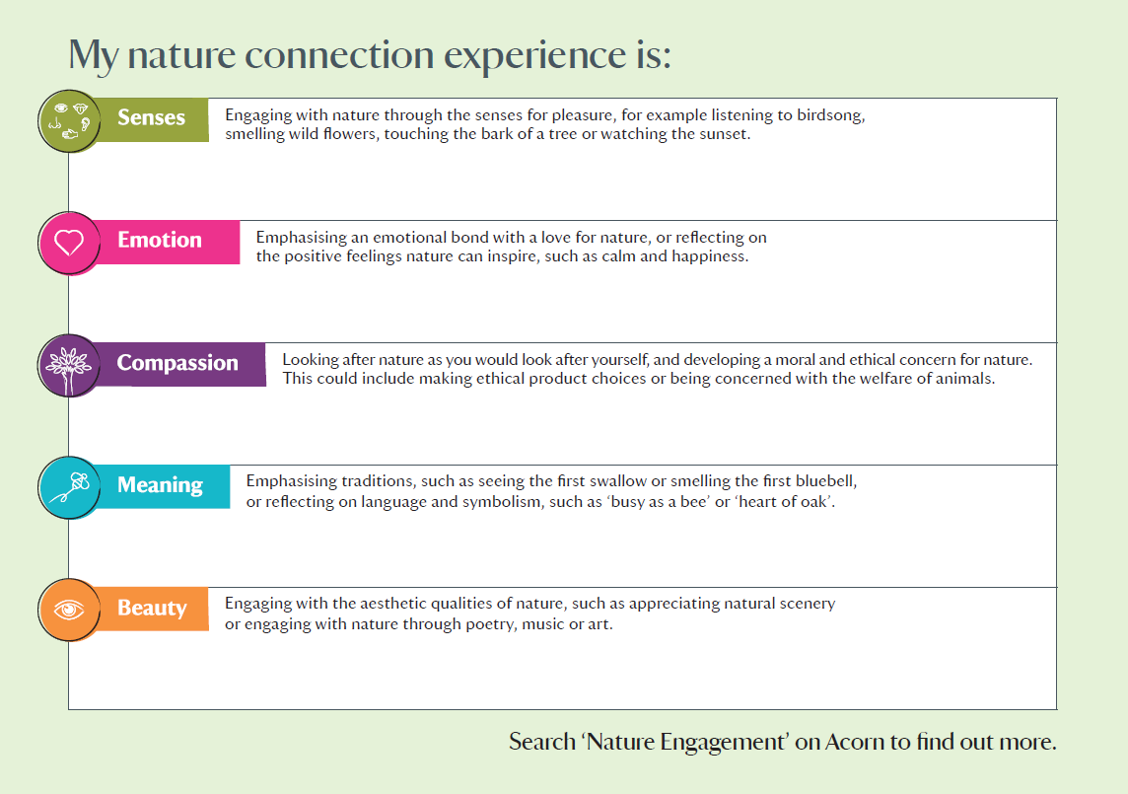
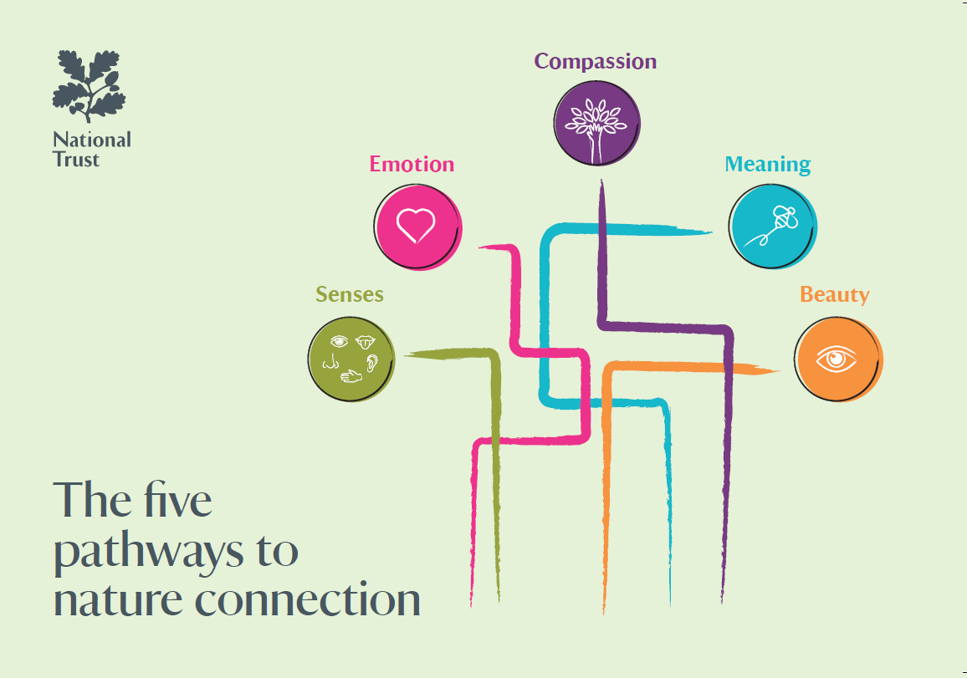
The Pathway Framework
Notes:
The pathways have been used successfully by a range of organisations to help enhance existing work with people of all ages to reconnect with nature. As a framework they can be utilised in the planning of activities by practitioners on an individual basis or within large organisations such as the work undertaken by the National Trust across all their properties. By mapping activities onto the Pathways at the planning stage, they can help provide a practical structure in which activities to engage people meaningfully with nature can be created that can draw upon the research while also utilising the experience of those delivering the session to create engaging and effective reconnection opportunities with nature.
[move onto slide 26]

Slide 26
Key Contacts
Dr Ryan Lumber
The University of Derby
r.lumber@derby.ac.uk
Prof Miles Richardson
The University of Derby
m.richardson@derby.ac.uk
https://findingnature.org.uk/
Martin Gilchrist
Natural England
Martin.Gilchrist@naturalengland.org.uk
Notes:
If you would like further details on the Pathways the following people can be contacted for further information
[move onto slide 27]

Slide 27
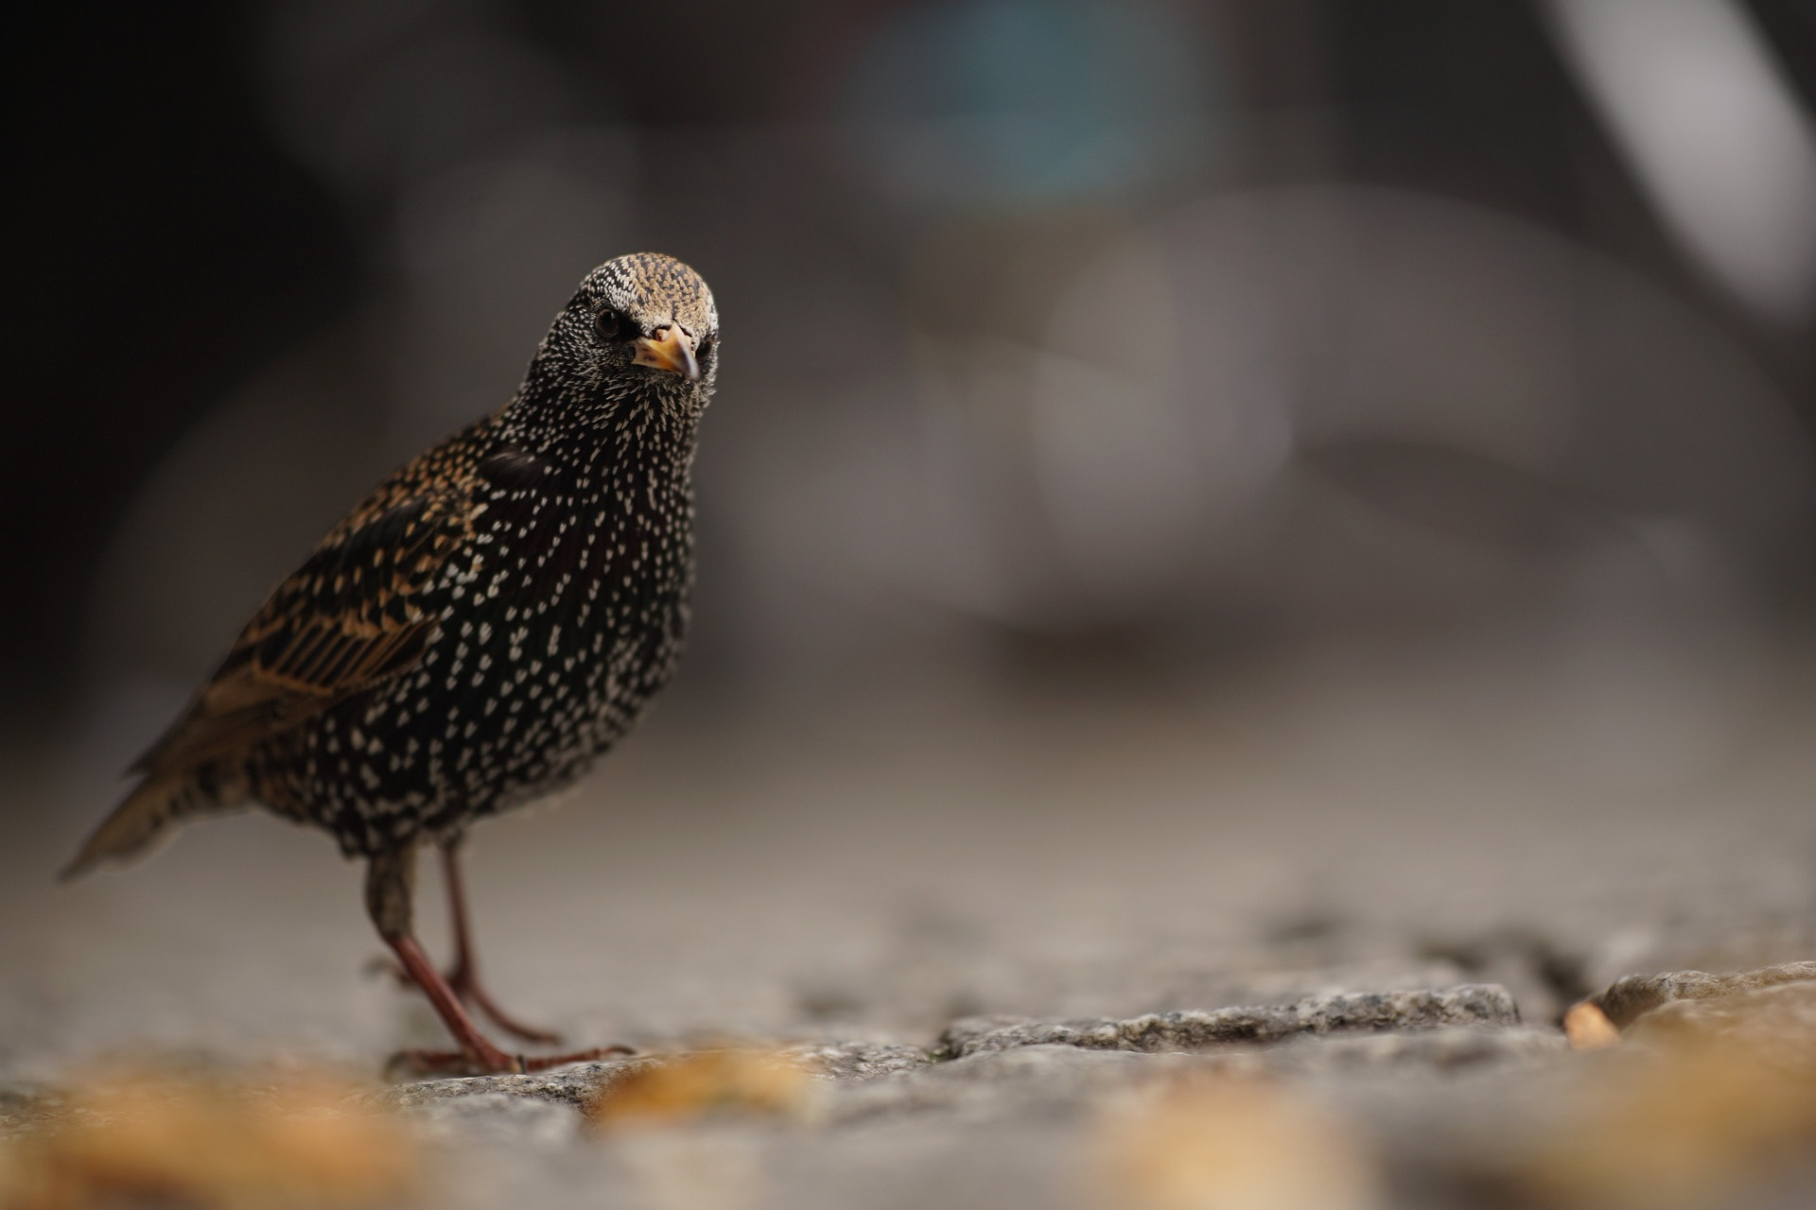
Thanks for Listening…
Any questions?
Notes:
But for now I’m happy to take any general questions
[presentation end]

