Slide 1
The Pathways in Action:
Case Studies
Notes:
Slide 1: Title and introduction
The purpose of this session is to build upon the overview of the pathways provided earlier to showcase some of the work done to successfully apply them in a range of settings both here in the UK and further afield
[Move onto slide 2]

Slide 2
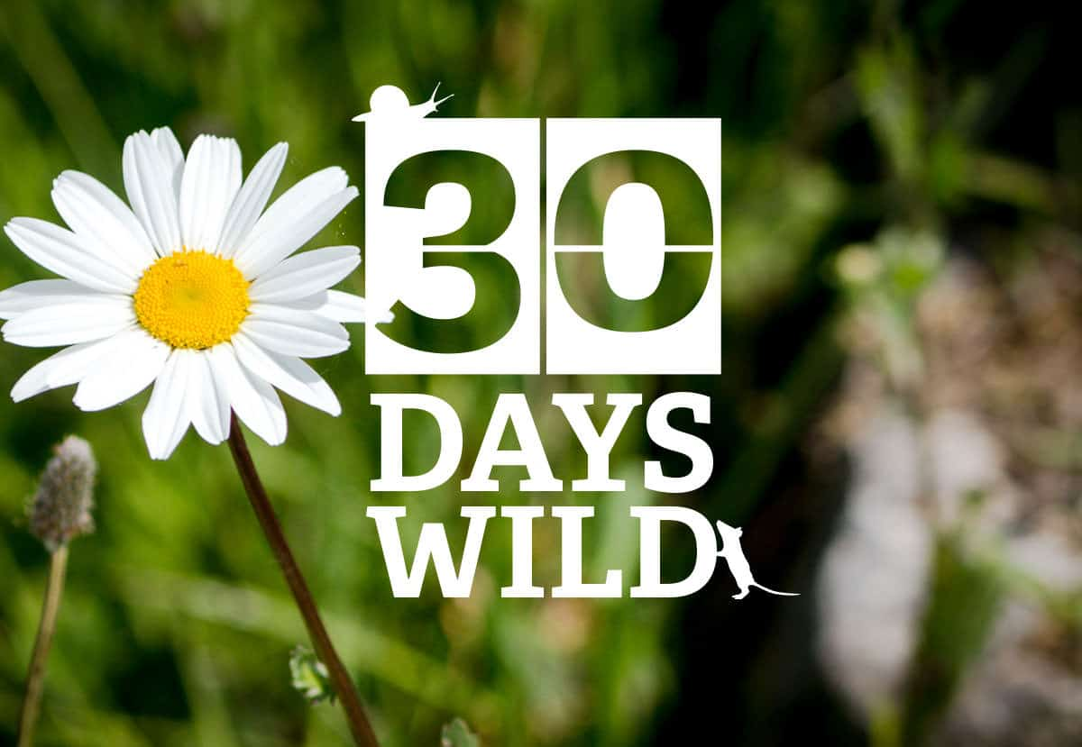
Notes:
Slide 2: 30 Days Wild
30 Days Wild is a yearly campaign run by the Wildlife Trusts that aims to draw attention to the natural world and normalise engagement with it and to provide a call to action for a large population. In June 2015 (and for the years since), people were encouraged to “do something wild every day” through a range of activities and to share what they did via social media. There was also an emphasis on self-direction with people encouraged to create their own activities inspired by those suggested.
[Move onto slide 3]

Slide 3
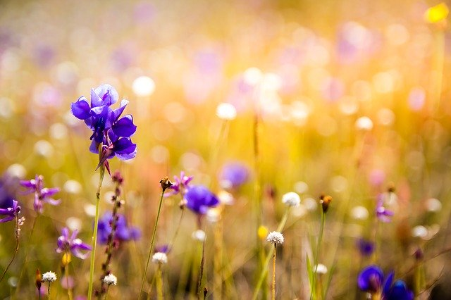
30 Days Wild
Incorporated the pathways into the 101 activities suggested in the 30 days wild campaign
Refined existing activities structured around noticing, sharing, doing and connecting made up of various complexities and frequencies
An example activity went from “go on a lunchtime walk in nature, what did you see?” to “go on a lunchtime walk; what did you see? To go on a lunchtime walk; how did it make you feel?”
Used with over 900 people, leading to a range of sustained wellbeing, health, pro-environmental and nature connectedness gains
Notes:
Slide 3: 30 Days Wild applying the pathways
The pathways were used in the designing of the 101 activities on offer for those taking part in the campaign. During planning, a list of potential activities of varying degrees of complexity and frequency were drawn up with the pathways used to refine their focus where needed. For example, the activity “go for a lunchtime walk; what did you see?” became ““go for a lunchtime walk; how did if make you feel?”
The campaign attracted a large number of people with over 900 taking part for the full 30 days, experiencing improved wellbeing, health, increased pro-environmental actions and greater nature connectedness as a result.
A full overview of the work and how the pathways were applied can be found here: https://journals.plos.org/plosone/article?id=10.1371/journal.pone.0149777
[Move onto slide 4]

Slide 4
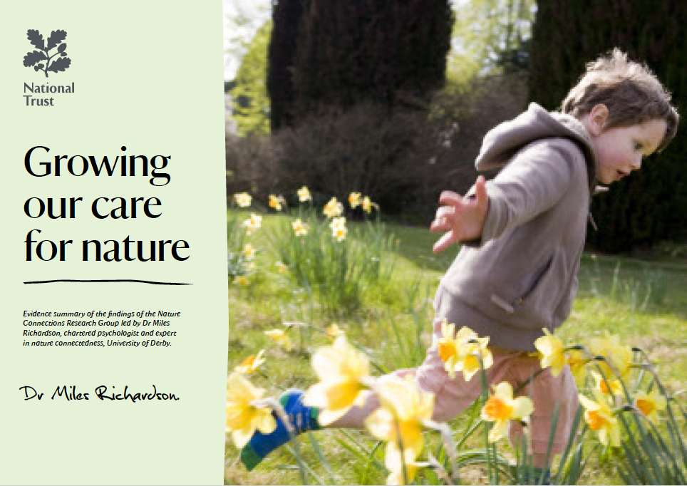
Notes:
Slide 4: The National Trust
The National Trust, an organisation with over 5 million members and around 26 million visitors a year adopted the pathways across their sites in two main ways:
In the reframing of the 50 things campaign for children
As a framework for designing or reframing activities by their visitor experience teams
[Move onto slide 5]

Slide 5
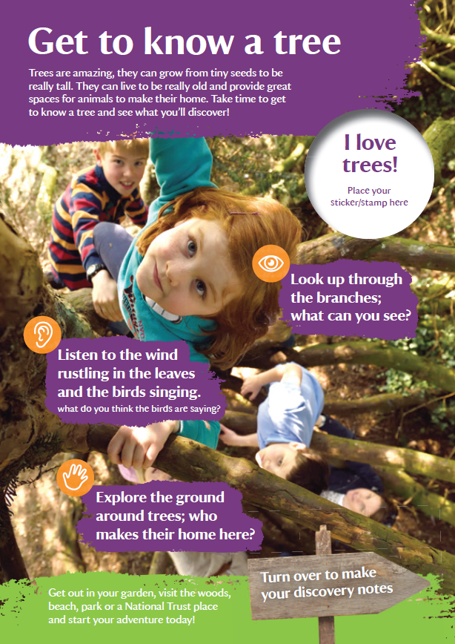
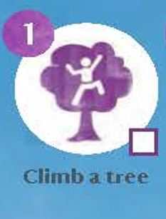
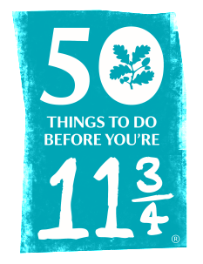
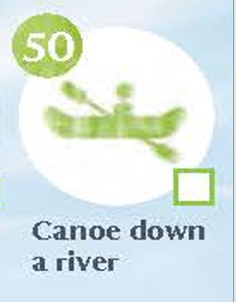
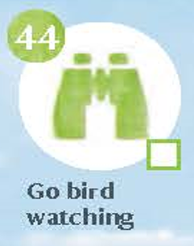
Notes:
Slide 5: The 50 Things Campaign
The 50 Things to do before you are 11 ¾’s is a campaign used on National Trusts sites to engage children with nature in meaningful ways. While successful, the National Trust wanted to ensure that nature connectedness was an outcome of their engagement with the activities. To do this, the pathways were used to help refine the activities to help them better reconnect children with nature. On the slides you can see three examples of what the original activity was and what it became through simple reframing through the pathways. The get to know a tree is a great example of the reframing process and the thinking behind it. As we previously heard, dominating nature was not a pathway to nature connectedness, therefore the original 50 Things activity would not have had the desired nature connecting effect.
During the reframing, it was noted that trees are remarkable places, favourite features of the landscape and can foster many types of relationship. They can be touched, smelt and heard, provide exhilaration, shelter and a home for wildlife. So climb if you will, but also get to know a tree and let them become steadfast companions and meaningful places. In the ‘getting to know a tree’ activity, the focus on the pathways is evident for example, “listen to the wind rustling in the leaves, and the birds singing” taps into the senses while “explore the ground around trees; who makes their home here?” taps into compassion. The National Trust did not need to create new activities entirely; drawing upon their existing work and expertise and reframing it through the pathways was all that was required to help enhance their provision for nature connection.
[Move onto slide 6]

Slide 6
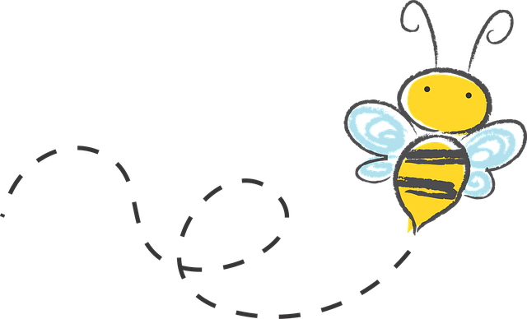
Example Case Studies
Exploring garden spaces for colours based on a colour wheel (senses & beauty)
A trail encouraging children to role-play as animals by smelling flowers like a bee, making a mouse den etc. (senses, emotion & compassion)
Installing natural art features which could be sat on to reflect and notice (meaning, emotion, beauty & senses)
Workshops to enable people to make homes for nature, creating art using natural materials, sound bathing in nature (senses, emotion, beauty, compassion)
Notes:
Slide 6: National Trust Visitor Engagement
Alongside the refinement of the 50 Things campaign, the National Trust were keen to embed the pathways within the provision of activities for their visitor engagement teams. Using the pathways as a guide again for their existing provision or for the creation of new activities using a simple grid system to match what was done within the activity with the five pathways, sites across the nation used them to reconnect people with nature. The activities on offer were sometimes simple and did not necessarily involve a large amount of financial investment. Some examples of the activities inspired by the pathways were:
Exploring garden spaces for colours based on a colour wheel (senses & beauty)
A trail encouraging children to role-play as animals by smelling flowers like a bee, making a mouse den etc. (senses, emotion & compassion)
Installing natural art features which could be sat on to reflect and notice (meaning, emotion, beauty & senses)
Workshops to enable people to make homes for nature, creating art using natural materials, sound bathing in nature (senses, emotion, beauty, compassion)
[Move onto slide 7]

Slide 7
Department of Conservation New Zealand
Notes:
Slide 7: Department of Conservation, New Zealand
The government agency responsible for New Zealand’s natural and historical heritage have also used the pathways within their work through their education provision, drawing upon the work of the National Trust and their 50 Things campaign.
[Move onto slide 8]

Slide 8
Department of Conservation New Zealand
Resources were created for teachers to engage children with nature and to reconnect with it through their lessons
The pathways were used to engage the teachers and to show them how they could be used in their classroom through activity cards that were inspired by the approach used by the National Trust
A campaign to engage children with nature through their own 50 things inspired by the pathways was also launched
Notes:
Slide 8: Department of Conservation, New Zealand
As part of their provision for educators, rsources were created for teachers to engage children with nature and to reconnect with it through their lessons that drew upon the pathways. During consultations with teachers who would potentially use the resources, it was found that without having a taster of what was involved, uptake would be minimal. The pathways were used to engage the teachers and to show them how they could be used in their classroom through activity cards that were inspired by the approach used by the National Trust. In addition, a campaign to engage children with nature through their own 50 Things was also launched drawing upon the pathway redesigned 50 Things of the National Trust in the UK but modified to take into account the cultural and geographical considerations of New Zealand.
[Move onto slide 9]

Slide 9
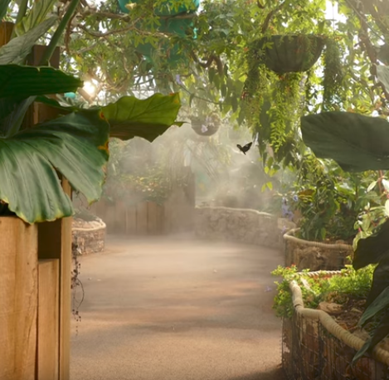
Notes:
Slide 9: Durrell Wildlife Trust
Durrell Wildlife Conservation Trust works internationally to protect endangered species and habitats while also running a wildlife preserve in Jersey that attracts around 169,000 visitors a year. The trust has recently updated its vision entitled ReWild our World.
[Move onto slide 10]

Slide 10
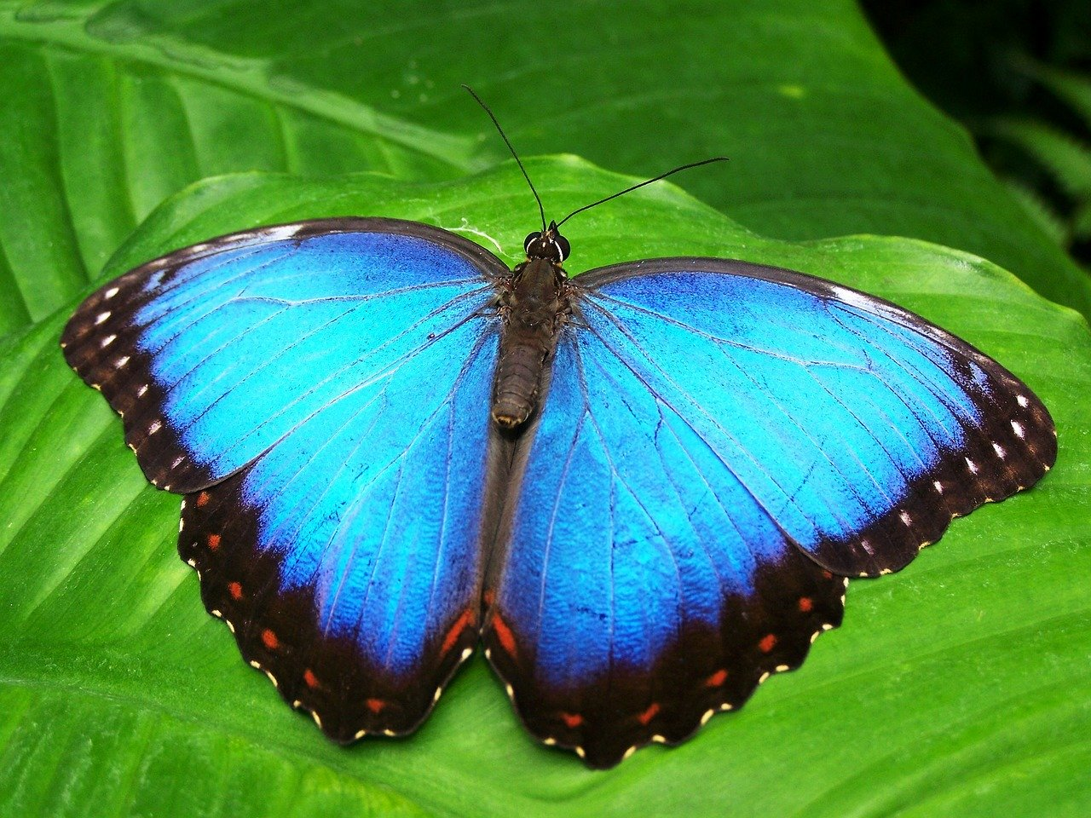
Durrell Wildlife Trust
Target of 1 million people reconnected with nature by 2025
Transitioned from mainly focusing on the presentation of facts at Jersey Zoo to reconnecting people via the pathways
Butterfly house focused on beauty
Visitor indicated they engaged their senses, experienced positive emotion and noticed nature’s beauty after visiting the butterfly kaleidoscope
Notes:
Slide 10: Durrell Wildlife Trust
As part of ReWild our World, Durrell see nature connectedness as a powerful concept that is not only important for wellbeing but also our relationship with the planet that will have implications for the ecosystems that we live in where a positive relationship with nature is needed. Durrell therefore aim to reconnect 1 million people with nature by 2025. To help achieve this, the pathways have been drawn upon in a number of ways to support their work:
Within Jersey Zoo, their wildlife preserve, a transition is taking place from mainly focusing on the presentation of facts onto the pathways to engage visitors with the animals within the preserve through the signage used and the opportunities and emphasis of engagement (i.e. through their animal encounters)
The redesign of the butterfly house at Jersey Zoo focused on beauty with visitor indications suggesting that they felt they had engaged their senses, experienced positive emotion and noticed beauty after visiting the Butterfly Kaleidoscope. At the end of the exhibit is an area that encourages visitors to protect the indigenous butterflies of the UK through activating compassion.
[Move onto slide 11]

Slide 11
Notes:
Slide 11: Summary
The case studies outlined are just some of the work that has been undertaken in applying the pathways to reconnect people with nature that have hopefully planted a seed in your mind as to how they could be applied. The practical sessions you have taken part on earlier coupled with the later session on activity planning will help you develop their use within your own context.
[End of presentation]

